Slide 1

Ethernet & Wireless Networking
A Comprehensive Guide to Wired & Wireless Infrastructure, Standards, Protocols, and Troubleshooting

Slide 2




Main Topics Covered
Ethernet Foundations
Cabling & Connectors
Ethernet Standards (IEEE 802.3), speeds, and common network hardware deployments.
UTP, STP, Fiber Optics, RJ-45, LC, SC, ST, and T568A/B wiring standards.
Wireless Networking
Security & Troubleshooting
Wi-Fi Standards (Wi-Fi 4 to Wi-Fi 7), SSIDs, frequency channels, and spectrums.
WPA2/WPA3 protocols, signal interference sources, and step-by-step troubleshooting.

Slide 3


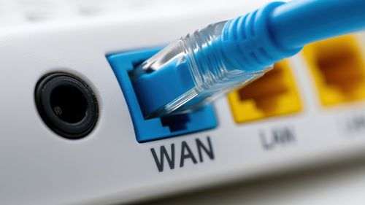
What is Ethernet?
Definition: Ethernet is the dominant wired networking technology used to interconnect devices.
Network Type: Primarily used in Local Area Networks (LANs) for high-speed local communication.
Hardware Required: Uses physical cables, RJ-45 connectors, network interface cards (NICs), and switches.
Key Concept: Ethernet remains the backbone of modern enterprise networks due to its unmatched bandwidth consistency and immunity to radio interference.
Core Benefit: Provides predictable, low-latency, high-reliability connection compared to wireless.

Slide 4






Common Uses of Ethernet
Workstations
Data Servers
Network Printers
IP Surveillance
Connecting office desktops and engineering workstations for latency-sensitive file access.
Linking enterprise database and cloud servers to network switches at 10G+ speeds.
Powering and transmitting video from IP security cameras using Power over Ethernet (PoE).
Providing centralized, dedicated network connectivity for shared office peripherals.

Slide 5

Ethernet Standards (IEEE 802.3)
Standard Name | Max Speed | Cable Requirement | Primary Application
10BASE-T | 10 Mbps | Cat3 / Cat5 UTP | Legacy Ethernet networks
100BASE-TX | 100 Mbps | Cat5 / Cat5e UTP | Fast Ethernet (Legacy LANs)
1000BASE-T | 1 Gbps (1,000 Mbps) | Cat5e / Cat6 UTP | Gigabit Ethernet (Standard LAN)
10GBASE-T | 10 Gbps | Cat6a / Cat8 UTP | Enterprise Workstations & Servers
100G Ethernet | 100 Gbps+ | Fiber Optic Cable | Data Center Backbones & ISPs
Rule of Thumb: Higher transmission speeds require higher quality cable shielding and enhanced switch hardware.

Slide 6


Ethernet Cable Types Overview
UTP (Unshielded Twisted Pair): Most common copper cable; budget-friendly and easy to install.
Cable Selection Factors
•
Required Speed: 1 Gbps vs 10 Gbps+
STP (Shielded Twisted Pair): Features metallic foil wrapping to eliminate EMI noise.
•
Distance: <100 meters (Copper) vs Kilometers (Fiber)
•
EMI Environment: Heavy machinery / power lines present?
Fiber Optic: Transmits light pulses via glass fibers for extreme speeds and long distances.
•
Budget Constraints: UTP < STP < Fiber Optic

Slide 7
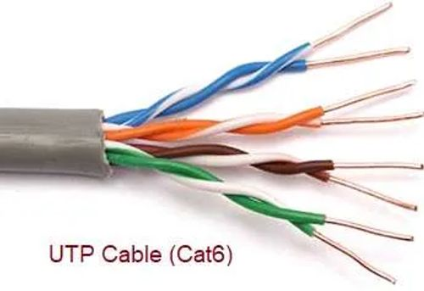

Unshielded Twisted Pair (UTP)
Structure: 4 color-coded pairs of copper wire twisted around each other to reduce internal crosstalk.
Common UTP Categories
Cat5e: Up to 1 Gbps @ 100m (100 MHz)
Key Advantages: Very low cost, lightweight, highly flexible, and universally standardized.
Cat6: Up to 10 Gbps @ 55m (250 MHz)
Cat6a: Full 10 Gbps @ 100m (500 MHz)
Best For: Home networks, office environments, and standard patch panels.
Cat8: Up to 25/40 Gbps @ 30m (2000 MHz)

Slide 8

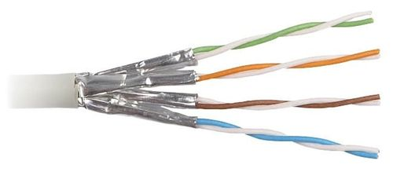

Shielded Twisted Pair (STP)
What is STP?
Pros vs. Cons
STP copper cable wraps individual wire pairs (or the overall cable bundle) in conductive metallic foil or braided wire mesh.
Advantages: Exceptional noise resistance in industrial settings; higher integrity over longer distances.
This barrier absorbs Electromagnetic Interference (EMI) and Radio Frequency Interference (RFI) from power lines and heavy equipment.
Disadvantages: Higher cost than UTP, stiffer to bend during installation, and strictly requires proper ground termination.

Slide 9
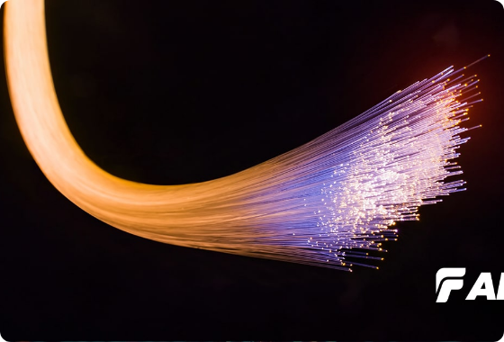
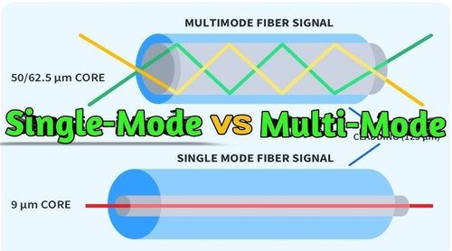
Fiber Optic Cable
Light Transmission: Transmits pulses of light through ultra-pure glass or plastic strands rather than electrical currents.
Immense Bandwidth: Capable of 100 Gbps+ speeds across dozens of kilometers without signal degradation.
100% EMI Proof: Entirely immune to electrical interference, lightning strikes, and cross-talk.
Two Core Types:
• Single-mode (SMF): Narrow core, laser light, ultra long distances.
• Multimode (MMF): Wider core, LED light, cost-effective for data centers.

Slide 10

UTP vs. STP vs. Fiber Optic
Feature | UTP (Unshielded Copper) | STP (Shielded Copper) | Fiber Optic
Medium | Twisted Copper Wire | Shielded Copper Wire | Glass / Plastic Core
Relative Cost | Low (Most Economical) | Medium | Higher (Specialized SMF)
EMI Protection | Low (Susceptible) | High (Shielded) | Complete Immunity
Max Distance | 100 Meters | 100 Meters | Up to 40+ Kilometers
Installation | Very Easy & Flexible | Moderate (Requires Ground) | Specialized / Precision

Slide 11
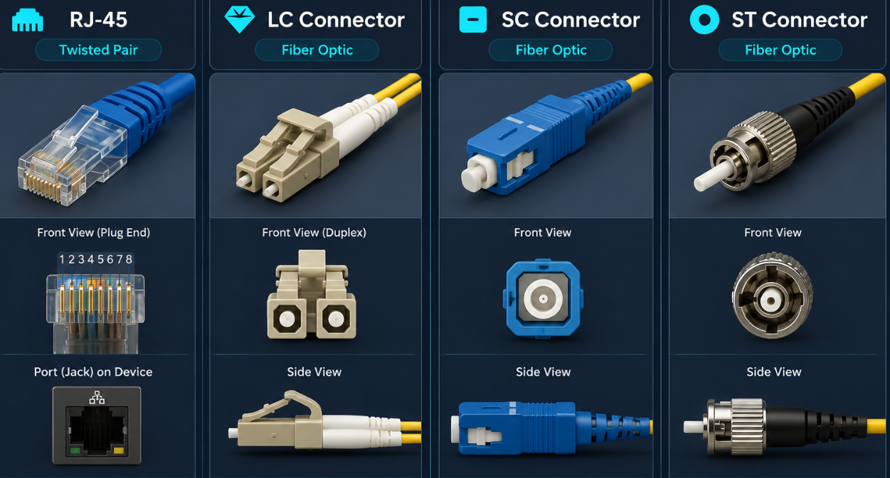





Network Connectors
RJ-45
LC Connector
SC Connector
ST Connector
Standard 8-position, 8-contact connector used for Ethernet UTP/STP cables worldwide.
Lucent Connector: Small Form Factor (SFF) push-pull connector popular in high-density switches.
Subscriber Connector: Square snap-in connector widely used in telecom and datacom environments.
Straight Tip: Older round bayonet twist-and-lock fiber connector common in legacy installations.

Slide 12




RJ-45 Pinouts & Cable Wiring
Cable Types
Wiring Standards
Standardized by TIA/EIA for pinout consistency:
Straight-Through Cable: Same pinout (T568B-T568B) on both ends. Connects different devices (Host to Switch).
T568A: GW, G, OW, B, BW, O, BRW, BR
Crossover Cable: T568A on one end, T568B on the other. Connects similar devices (Switch to Switch).
T568B: OW, O, GW, B, BW, G, BRW, BR
Auto MDI-X: Modern switches automatically detect required wire pairs, eliminating the need for crossover cables!

Slide 13

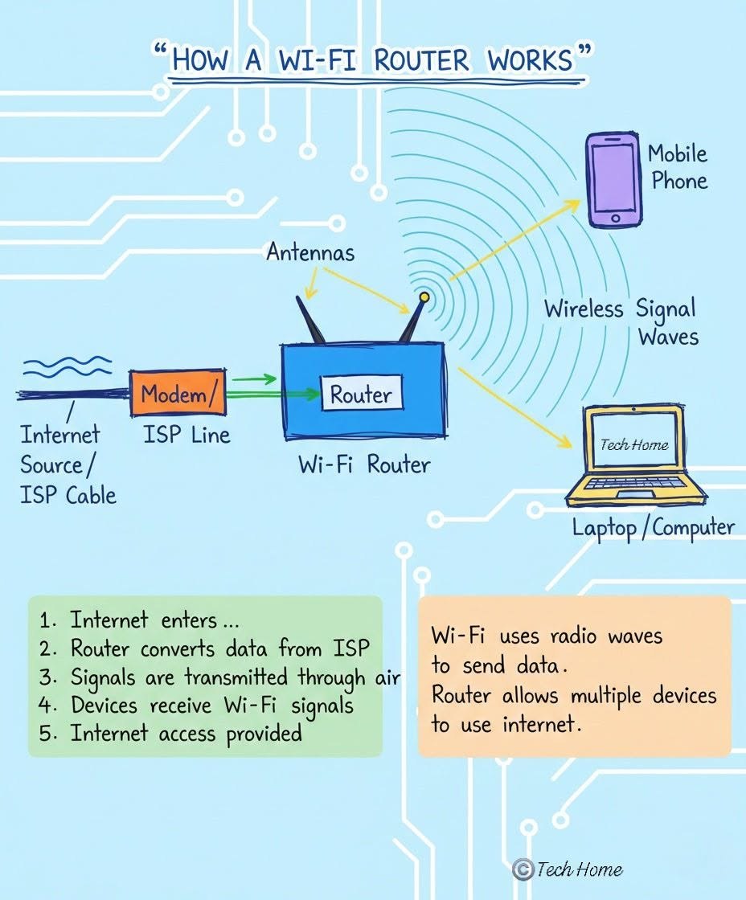
What is Wi-Fi?
Wireless LAN (WLAN): Wi-Fi connects devices using high-frequency radio waves instead of physical cables.
Radio Frequency Bands: Operates primarily in 2.4 GHz, 5 GHz, and newly added 6 GHz spectrums.
Universal Access: Connects smartphones, laptops, IoT sensors, tablets, smart TVs, and medical equipment seamlessly.
Flexibility vs Security: Provides maximum mobility, but requires robust encryption as data travels through open air.

Slide 14

Evolution of Wi-Fi Standards
Standard | Marketing Name | Frequencies | Max Speed (Theoretical)
IEEE 802.11n | Wi-Fi 4 | 2.4 GHz / 5 GHz | 600 Mbps
IEEE 802.11ac | Wi-Fi 5 | 5 GHz | 6.9 Gbps
IEEE 802.11ax | Wi-Fi 6 / 6E | 2.4 GHz / 5 GHz / 6 GHz | 9.6 Gbps
IEEE 802.11be | Wi-Fi 7 | 2.4 GHz / 5 GHz / 6 GHz | 46 Gbps+
Note: Newer standards introduce technologies like OFDMA and 320 MHz channels to handle dense, high-device environments efficiently.

Slide 15
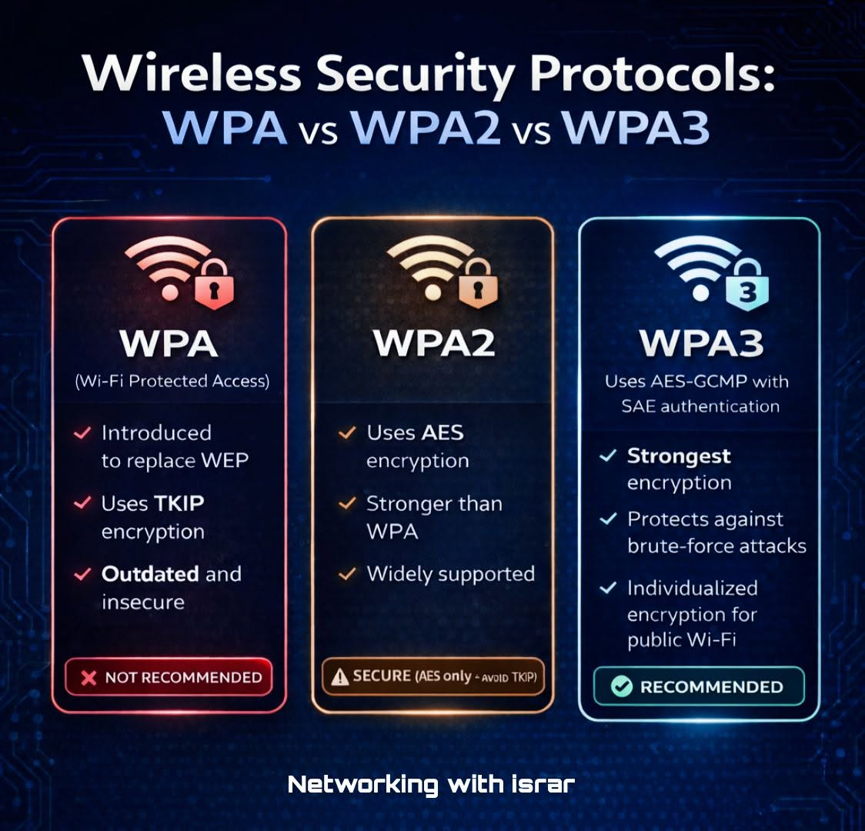
Wireless Security Protocols
WEP (Wired Equivalent Privacy): Severely flawed & deprecated. Easily cracked in minutes. Never use.
WPA / WPA2: Introduces TKIP & strong AES encryption. Standard for over a decade.
WPA3: Modern gold standard. Features SAE (Simultaneous Authentication of Equals) to prevent brute-force attacks.

Slide 16



What is an SSID?
Definition & Purpose
Security Considerations
SSID stands for Service Set Identifier. It is the human-readable 32-character name broadcast by access points to identify a wireless network.
Connecting users select the SSID and enter credentials.
Important Myth: Hiding an SSID (disabling broadcast) is not a true security measure, as network scanners easily detect hidden packet headers.
Examples: Campus_Guest, Office_5G, Home_Network

Slide 17






Wi-Fi Channels & Spectrum
2.4 GHz Band
5 GHz Band
6 GHz Band
Only 3 non-overlapping channels (1, 6, 11). Extremely prone to congestion from microwaves & Bluetooth.
Offers 20+ non-overlapping channels. Less congestion, wider bandwidth, but shorter signal propagation through walls.
Introduced in Wi-Fi 6E/7. Unlocked huge clean spectrum with up to 1,200 MHz of bandwidth for ultra-low latency.

Slide 18



Wi-Fi Interference
Effects & Remediation
Common Sources of EMI
Effects: High latency, packet loss, frequent drops, slow throughput.
Overlapping Neighboring Wi-Fi Networks
Microwave Ovens & Bluetooth Dongles
Concrete Walls, Metal Mirrors, and Tinted Glass
Remediation: Switch to channels 1, 6, or 11; migrate clients to 5/6 GHz bands; reposition Access Points central to clients.

Slide 19










Troubleshooting Wireless Issues
Physical Checks
Authentication
Signal & Range
Channel Analysis
Driver / Firmware
Ensure Wi-Fi toggle is ON & AP has power / ethernet connection.
Verify SSID name & confirm correct WPA2/WPA3 password entry.
Check RSSI signal strength; move closer to reduce attenuation.
Scan for co-channel interference & switch AP to clean channel.
Update network NIC drivers and Access Point firmware version.

Slide 20


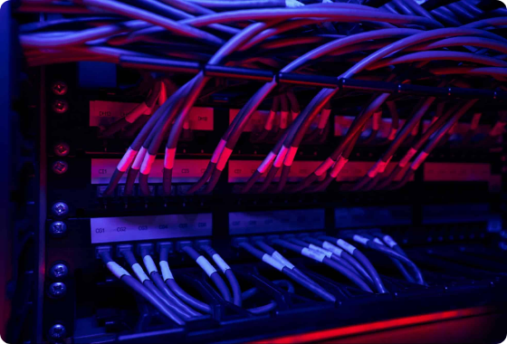
Real-World Troubleshooting Scenario
"Connected to Wi-Fi, but internet is extremely slow."
Step 1: Check RSSI (Received Signal Strength Indicator)
Step 2: Analyze AP channel saturation (Channel 6 is overcrowded).
Step 3: Test router uplink speed.
Solution Applied: Relocated user to 5 GHz band, changed AP to non-overlapping Channel 11, and rebooted local gateway.

Slide 21


Wired (Ethernet) vs. Wireless (Wi-Fi)
Ethernet (Wired)
Wi-Fi (Wireless)
Maximum stability & low latency
Ultimate device mobility & convenience
High bandwidth (up to 100 Gbps)
Rapid deployment for guests & mobile
Zero device mobility
Vulnerable to radio interference
Higher physical cabling cost
Requires strict encryption policies

